Slide 1
Smart Home Automation System

Slide 2
Prepared by :
1. Harsh Chauhan 180163107005
2. Jaydeep Virani 170160107123
3. Parth Unjiya 170160107118
4. Vaidik Radadiya 170160107091

Slide 3
Index
1. Limitation of existing system
2. Introduction
3. Scope
4. Circuit Layouts
5. Arduino IDE
6. Pros and Cons
7. Future Plans
8. References

Slide 4
Limitation of existing system
In market this type of project is already out but there is separate appliance like remotely controlled lights and fan and many more things so we need to have that particular remote to control that things
But in this project everything is centrally controlled connected to one device so all things can be globally controlled from any where.

Slide 5
Introduction
- The Smart Home Automation System is an IoT based electronic system, which is constructed using the device(ESPWifi 8266-12E).
- However this controlling isn’t limited up to virtual application interface but the home appliances are switched ON/OFF using unique gestures of user.
- While using this system there is no effect on existing system user can use both mode dedicated switch as well as application switch.

Slide 6
Scope
- The user just need a network connection to establish communication with appliances by application interface with the help of smartphone, the user can control the basic home appliances, i.e. fan, bulb/lamps, TV, Fridge, AC etc. from anywhere in network.
- Particular user acts as a client to the NodeMCU server and get responses at particular pins acquired for the no. of appliances.
- It looks like client-server based system where client requests to the server and it sends the control command to microcontroller and the corresponding pin/switch gets digital signal ,either to turn ON or OFF.

Slide 7
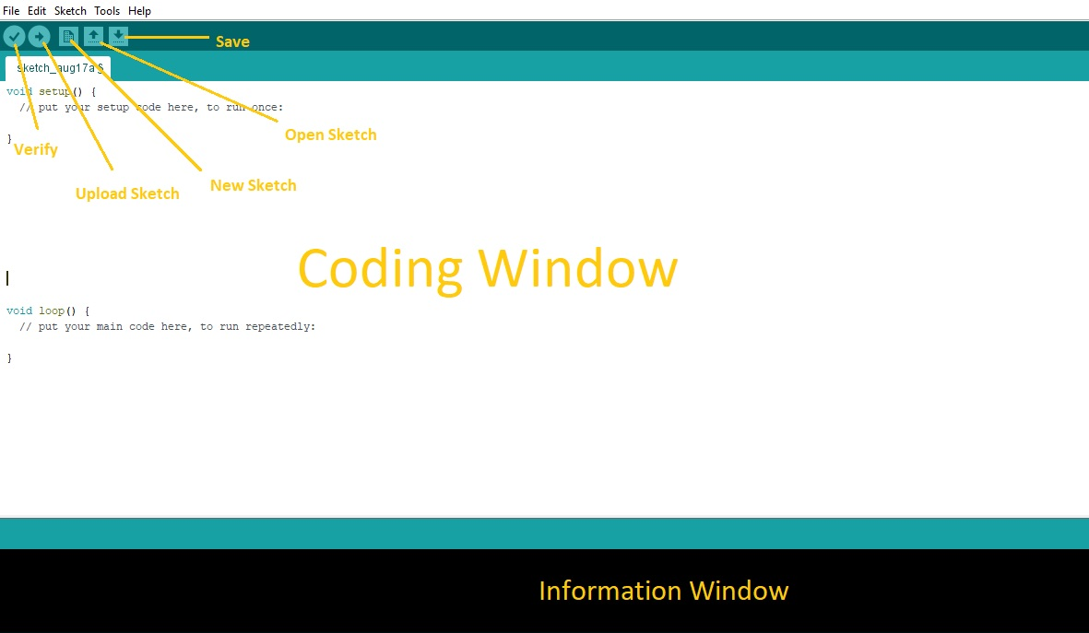
Arduino IDE

Slide 8
Circuit Used in System
ESPWifi 8266-12E NodeMCU Devp. Board
8-channel 5V-10A/12V-15ADC Relay Module
LDR sensor
Gas MQTT sensor
Ultrasonic Sensor

Slide 9
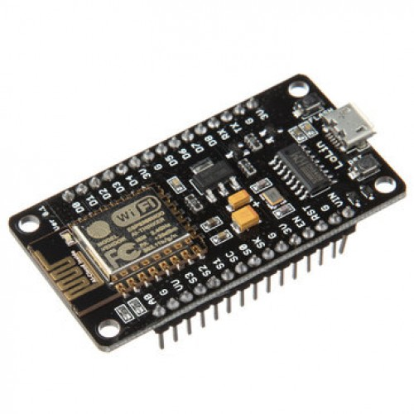
ESPWifi 8266-12E NodeMCU Devp. Board
NodeMCU is an open-source IOT platform. It refers to an Lua based firmware developed for ESP8266 Wifi SOC(System On Chip) from Espressif Systems.
The ESP8266 is a 3.3V microcontroller, so its I/O operates at 3.3V as well.
The maximum current that can be drawn from a single GPIO pin is 12mA.
This version of Wifi module has an programmable controller along with Wifi, so there is no need to attach it with other controller devices like Arduino/Raspberry Pi(for small scale projects).

Slide 10
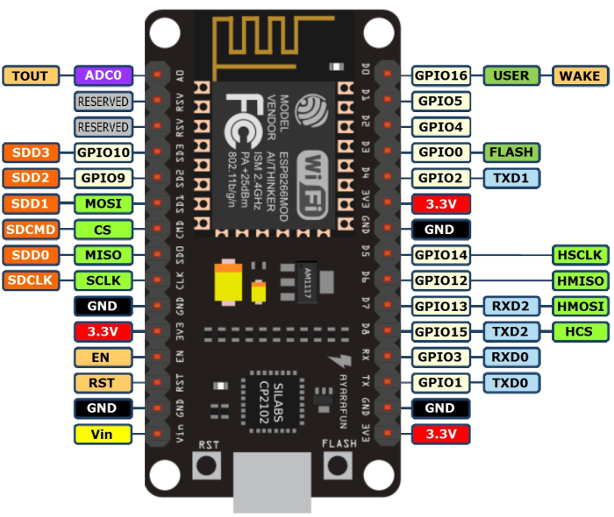
ESPWifi 8266-12E NodeMCU Devp. Board

Slide 11
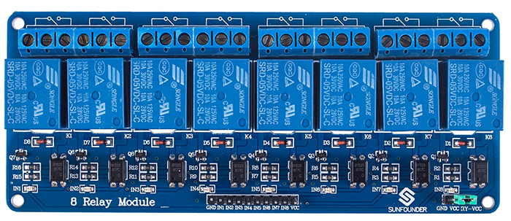
8-channel 5VDC Opto-coupler Relay Module
8-channel relay module is the electronic device which performs the actual switching of the home appliances. It operates on 3.3V/5V DC and working is based on optical coupling.

Slide 12
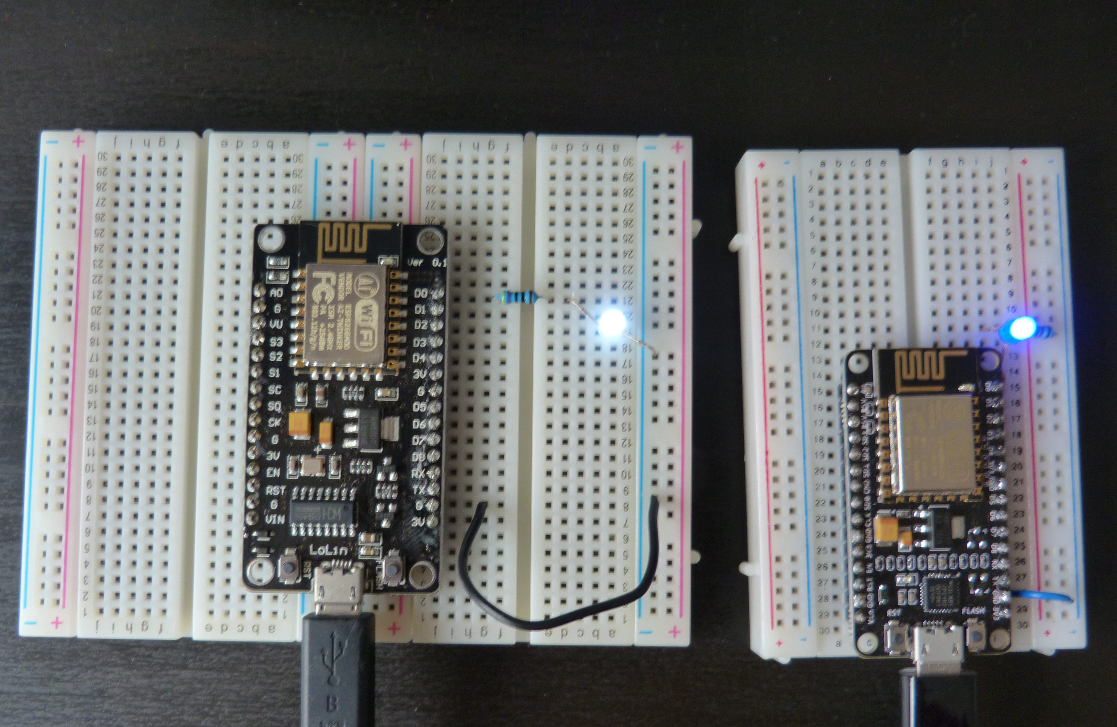

Slide 13
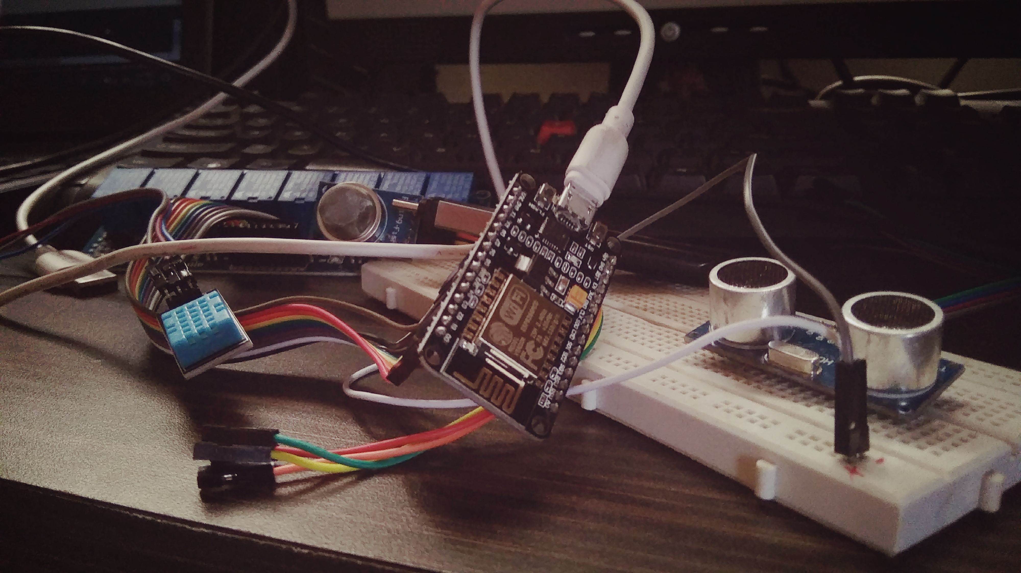

Slide 14
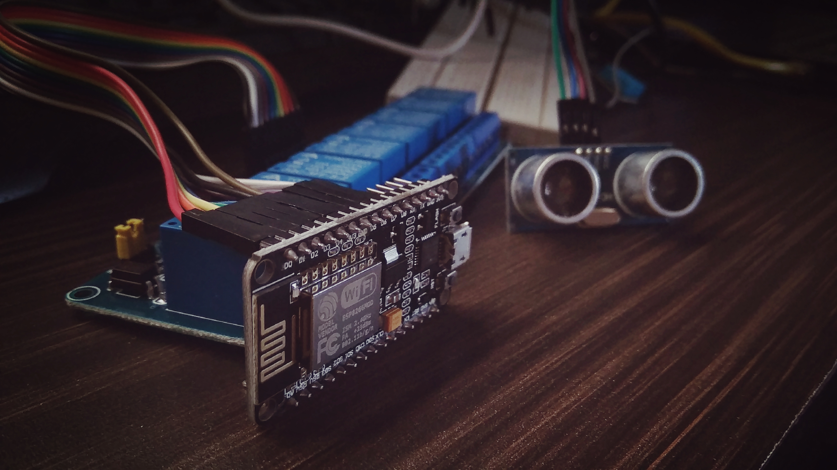

Slide 15
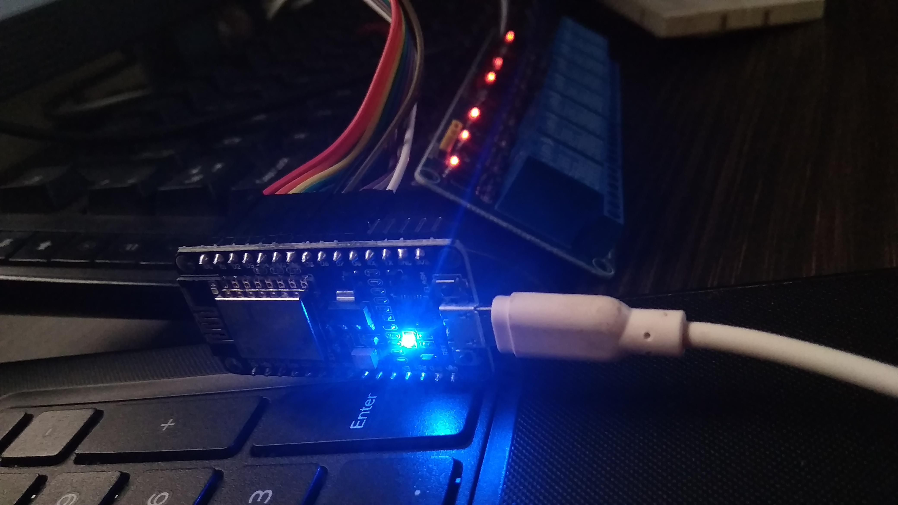

Slide 16
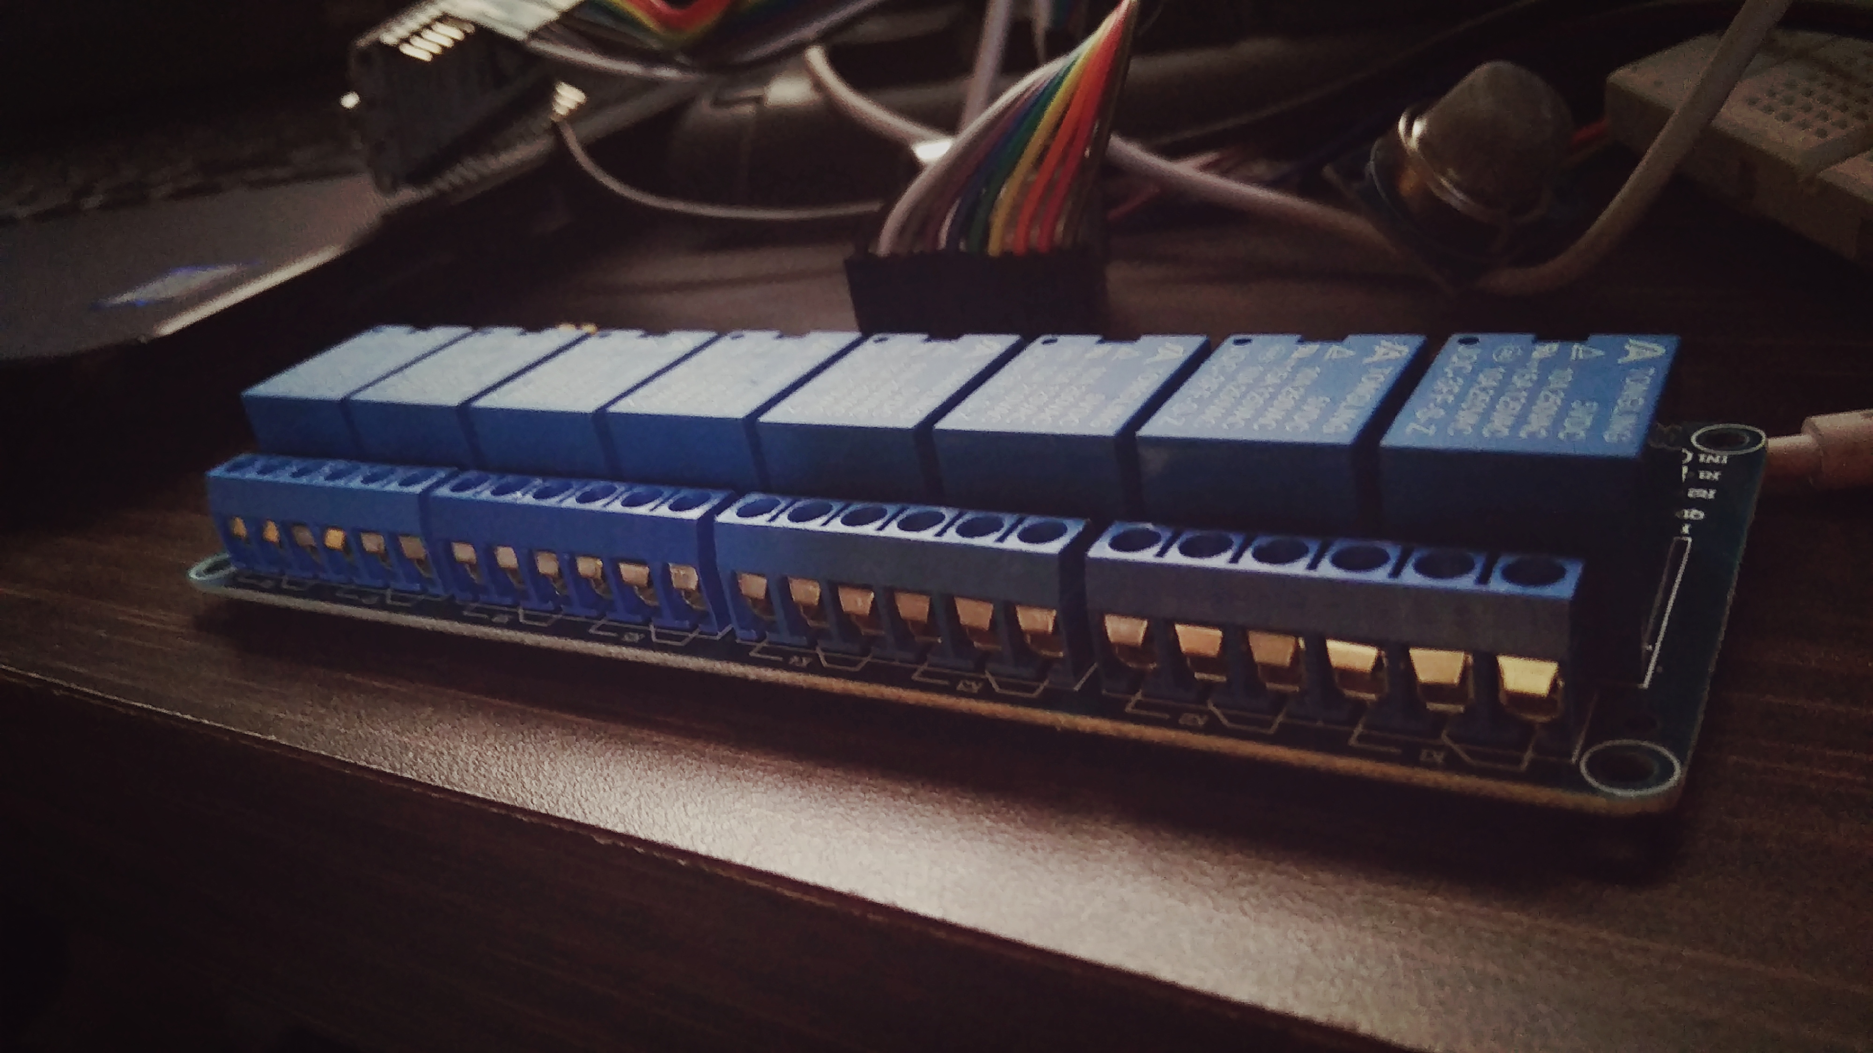

Slide 17
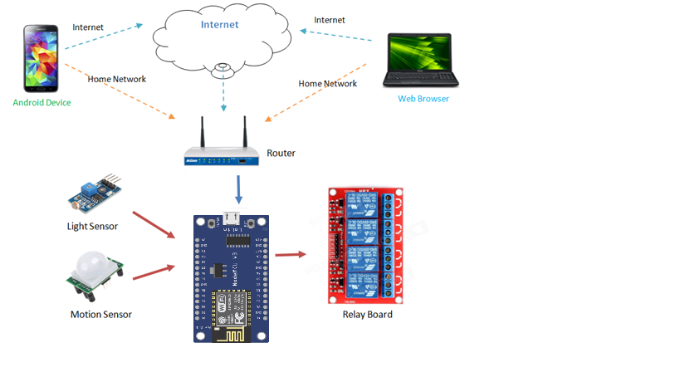
Working Process

Slide 18
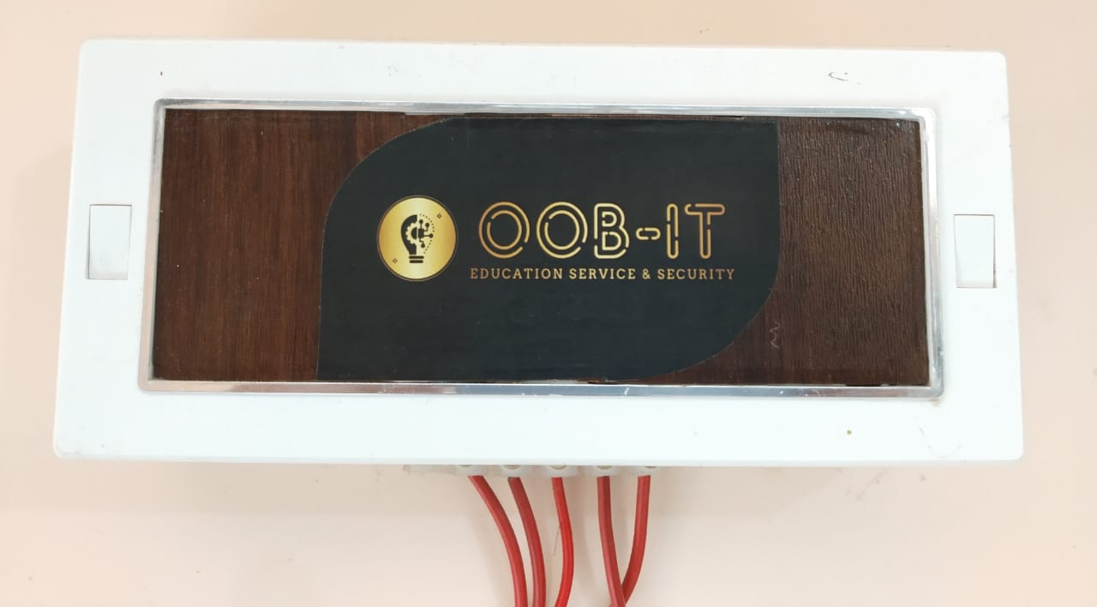
Smart Home Controller box

Slide 19
Pros and Cons
Reliable
Secure
Portable
Cost effective
Accurate
Simple
User-defined
Needs Maintenance (disadvantage)
Not efficient for high power devices (disadvantage)

Slide 20
Future Plans
- We decided to learn more about the parts as well as pins of the components used, so we can add extra functionalities to our project.
- We worked on the GPIO pins and further we’ll test it with other sensors as the ESPWifi is capable to connect 2-3 other devices like gas sensor and temperature sensor, etc.
- We’ll integrate the two different modules (1. Online module : 2. Offline module) within a single mobile application.

Slide 21
References
Iotbytes
https://iotbytes.wordpress.com
Arduino
https://www.arduino.cc
Wikipedia
https://en.wikipedia.org/wiki/Smart_home_technology
GitHub
https://github.com/topics/smarthome
OOBIT community support
https://oob-it.web.app/

Slide 22
Thank You!

